Slide 1

Breast Cancer Prediction using Machine Learning
Presented by: [Abdelrahman Helmy]
Course: [huawei Ai]
This project demonstrates how Machine Learning can be applied to predict whether a tumor is malignant or benign, using two classification models: Logistic Regression and Random Forest.

Slide 2

The Challenge: Early & Accurate Breast Cancer Diagnosis
Breast cancer remains one of the leading causes of death among women globally. Early detection is paramount, significantly increasing the chances of survival and improving patient outcomes.
However, traditional diagnostic methods, relying heavily on medical imaging and human expertise, can be subjective, time-consuming, and prone to variability. This presents a critical bottleneck in healthcare.
"How can we leverage machine learning to assist medical professionals by providing fast, objective, and highly accurate predictions for cancer diagnosis?"

Slide 3





Machine Learning: A Powerful Ally in Diagnosis
Machine learning offers a transformative approach to augment medical diagnosis, providing critical support to healthcare professionals.
Enhanced Accuracy
Algorithms can identify subtle patterns often missed by the human eye.
Rapid Predictions
Automated systems deliver diagnoses in minutes, speeding up patient care pathways.
Objective Analysis
Reduces subjectivity, providing consistent and unbiased diagnostic support.
Clinical Support
Assists doctors in making more informed and confident decisions.

Slide 4

Dataset Deep Dive: Wisconsin Breast Cancer
Our project utilizes the renowned Breast Cancer Wisconsin (Diagnostic) Dataset. This dataset is a standard benchmark in the machine learning community, ideal for binary classification tasks.
Samples: 569 instances of breast cancer cases.
Features: 30 robust numeric features describing tumor characteristics.
Examples: Radius, Texture, Perimeter, Area, Smoothness, Compactness, Concavity, etc.
The target variable clearly differentiates between:
0 → Benign (non-cancerous)
1 → Malignant (cancerous)
Visual representation of cellular differences.

Slide 5

Why the Wisconsin Breast Cancer Dataset?
Selecting the right dataset is foundational to any robust machine learning project. The Wisconsin Breast Cancer dataset offers distinct advantages for this study.
Reliable & Real-World
Clean & Accessible
Collected from real medical cases, ensuring authenticity and clinical relevance.
Minimally preprocessed, reducing initial data preparation overhead. Publicly available for research.
Balanced Classes
Numeric Features
Sufficient representation of both benign and malignant cases for fair model training.
Directly consumable by ML algorithms, avoiding complex transformations.

Slide 6
Our Machine Learning Workflow: A Structured Approach
Building a reliable prediction model requires a systematic process, from raw data to actionable insights.
01
02
03
Data Collection
Data Preprocessing
Exploratory Data Analysis (EDA)
Identifying and acquiring the appropriate dataset for the task.
Cleaning, transforming, and preparing the data for analysis and modeling.
Understanding data patterns, distributions, and relationships through statistics and visualizations.
04
05
06
Feature Selection
Model Building
Model Evaluation
Identifying the most relevant features to optimize model performance and interpretability.
Applying chosen machine learning algorithms to train the predictive model.
Assessing model performance using various metrics on unseen data.
07
Conclusion & Future Work
Interpreting results, drawing conclusions, and outlining next steps for improvement.

Slide 7

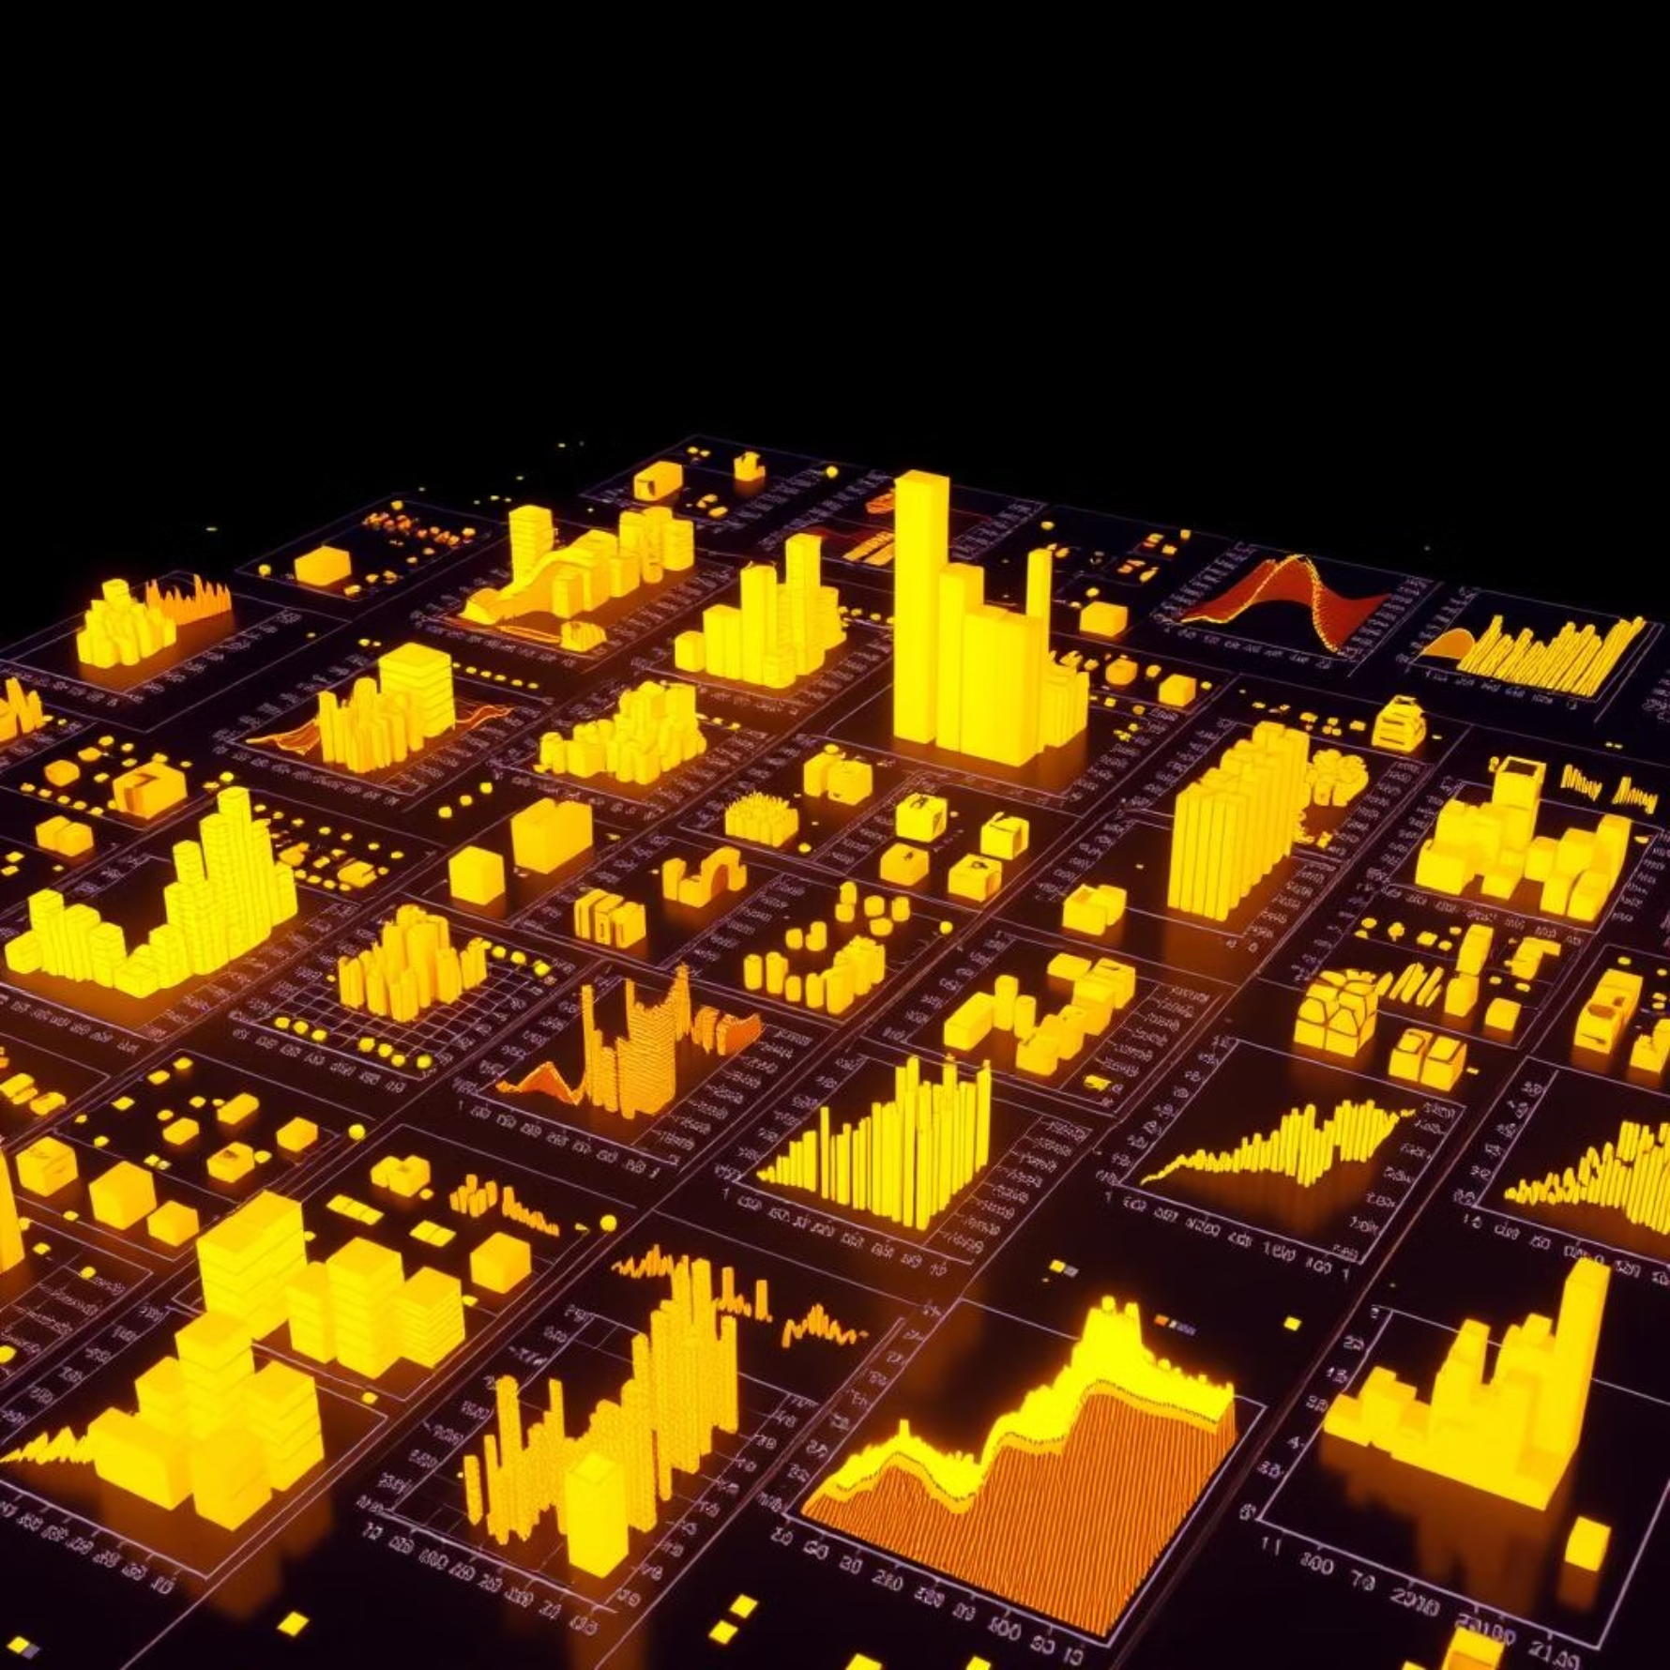
Data Preparation: Preprocessing and EDA
Preprocessing Steps
Data Cleaning: Verified the dataset's integrity; no missing values were found, ensuring a robust starting point.
Feature Standardization: Scaled all features to a similar range (mean=0, variance=1), crucial for models like Logistic Regression.
Train-Test Split: Divided the dataset into 80% for training and 20% for testing, to evaluate generalization on unseen data.
Exploratory Data Analysis (EDA)
EDA provided crucial insights into the dataset's structure and feature relationships.
Feature Distributions: Analyzed characteristics like radius_mean and texture_mean, which showed distinct patterns for malignant vs. benign cases.
Correlation Analysis: Identified highly correlated features to potentially reduce redundancy and simplify models.
Visualizations: Histograms, scatter plots, and heatmaps revealed how features interact and separate the two target classes effectively.

Slide 8


Introducing Our Models: Logistic Regression & Random Forest
We selected two distinct classification algorithms to build our predictive models, each offering unique advantages for this medical diagnosis task.
Logistic Regression
Random Forest
A powerful statistical model for binary classification. It uses a sigmoid function to map predictions to probabilities (0 to 1), making it simple, fast, and highly interpretable.
An ensemble learning method that aggregates predictions from multiple Decision Trees. This approach enhances robustness, reduces overfitting, and captures complex non-linear relationships.
Easy to explain to non-technical audiences.
Handles complex data and non-linearities.
Provides feature coefficients for interpretability.
Reduces overfitting through ensemble averaging.
Excellent baseline performance.
Provides crucial feature importance scores.

Slide 9
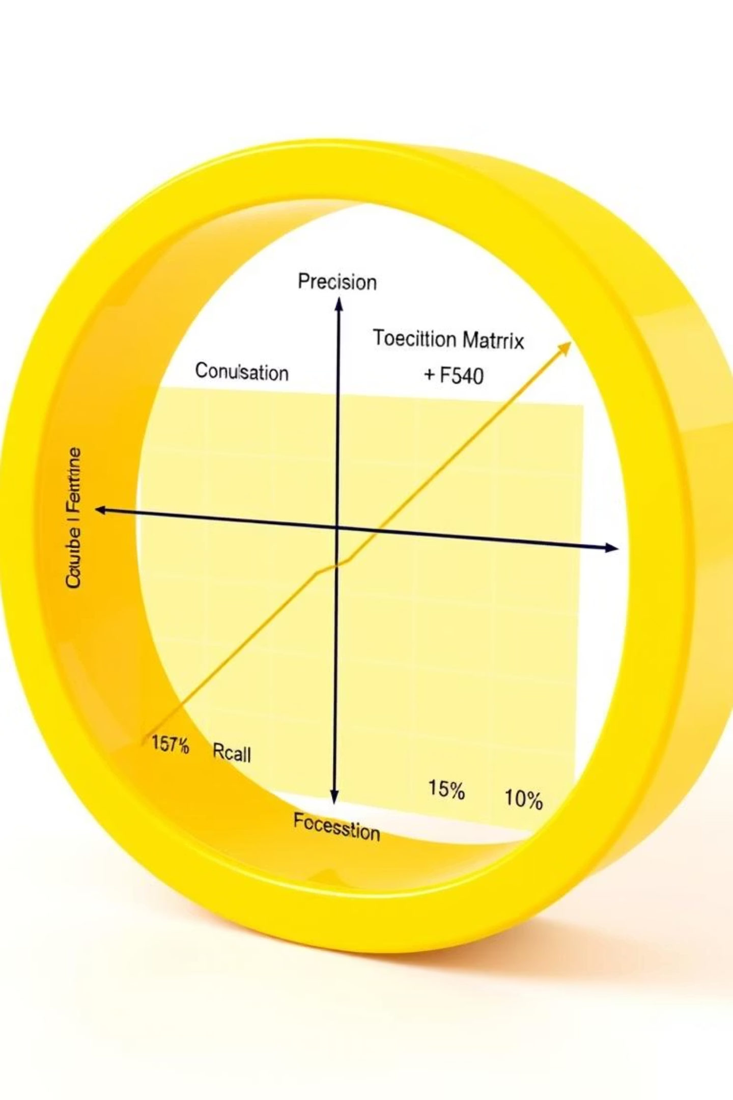
Evaluating Performance: Metrics for Medical Accuracy
To rigorously assess our models, we focused on a suite of metrics critical for reliable medical diagnostic applications.
Accuracy
The proportion of correctly classified instances (both benign and malignant) out of the total.
Precision
Out of all cases predicted as malignant, how many were actually malignant? Minimizes false positives.
Recall (Sensitivity)
Out of all actual malignant cases, how many were correctly identified? Crucial for not missing true cancer cases.
F1-Score
The harmonic mean of precision and recall, providing a balanced measure of the model's performance.
Additionally, a Confusion Matrix offers a detailed breakdown of True Positives, True Negatives, False Positives, and False Negatives.

Slide 10

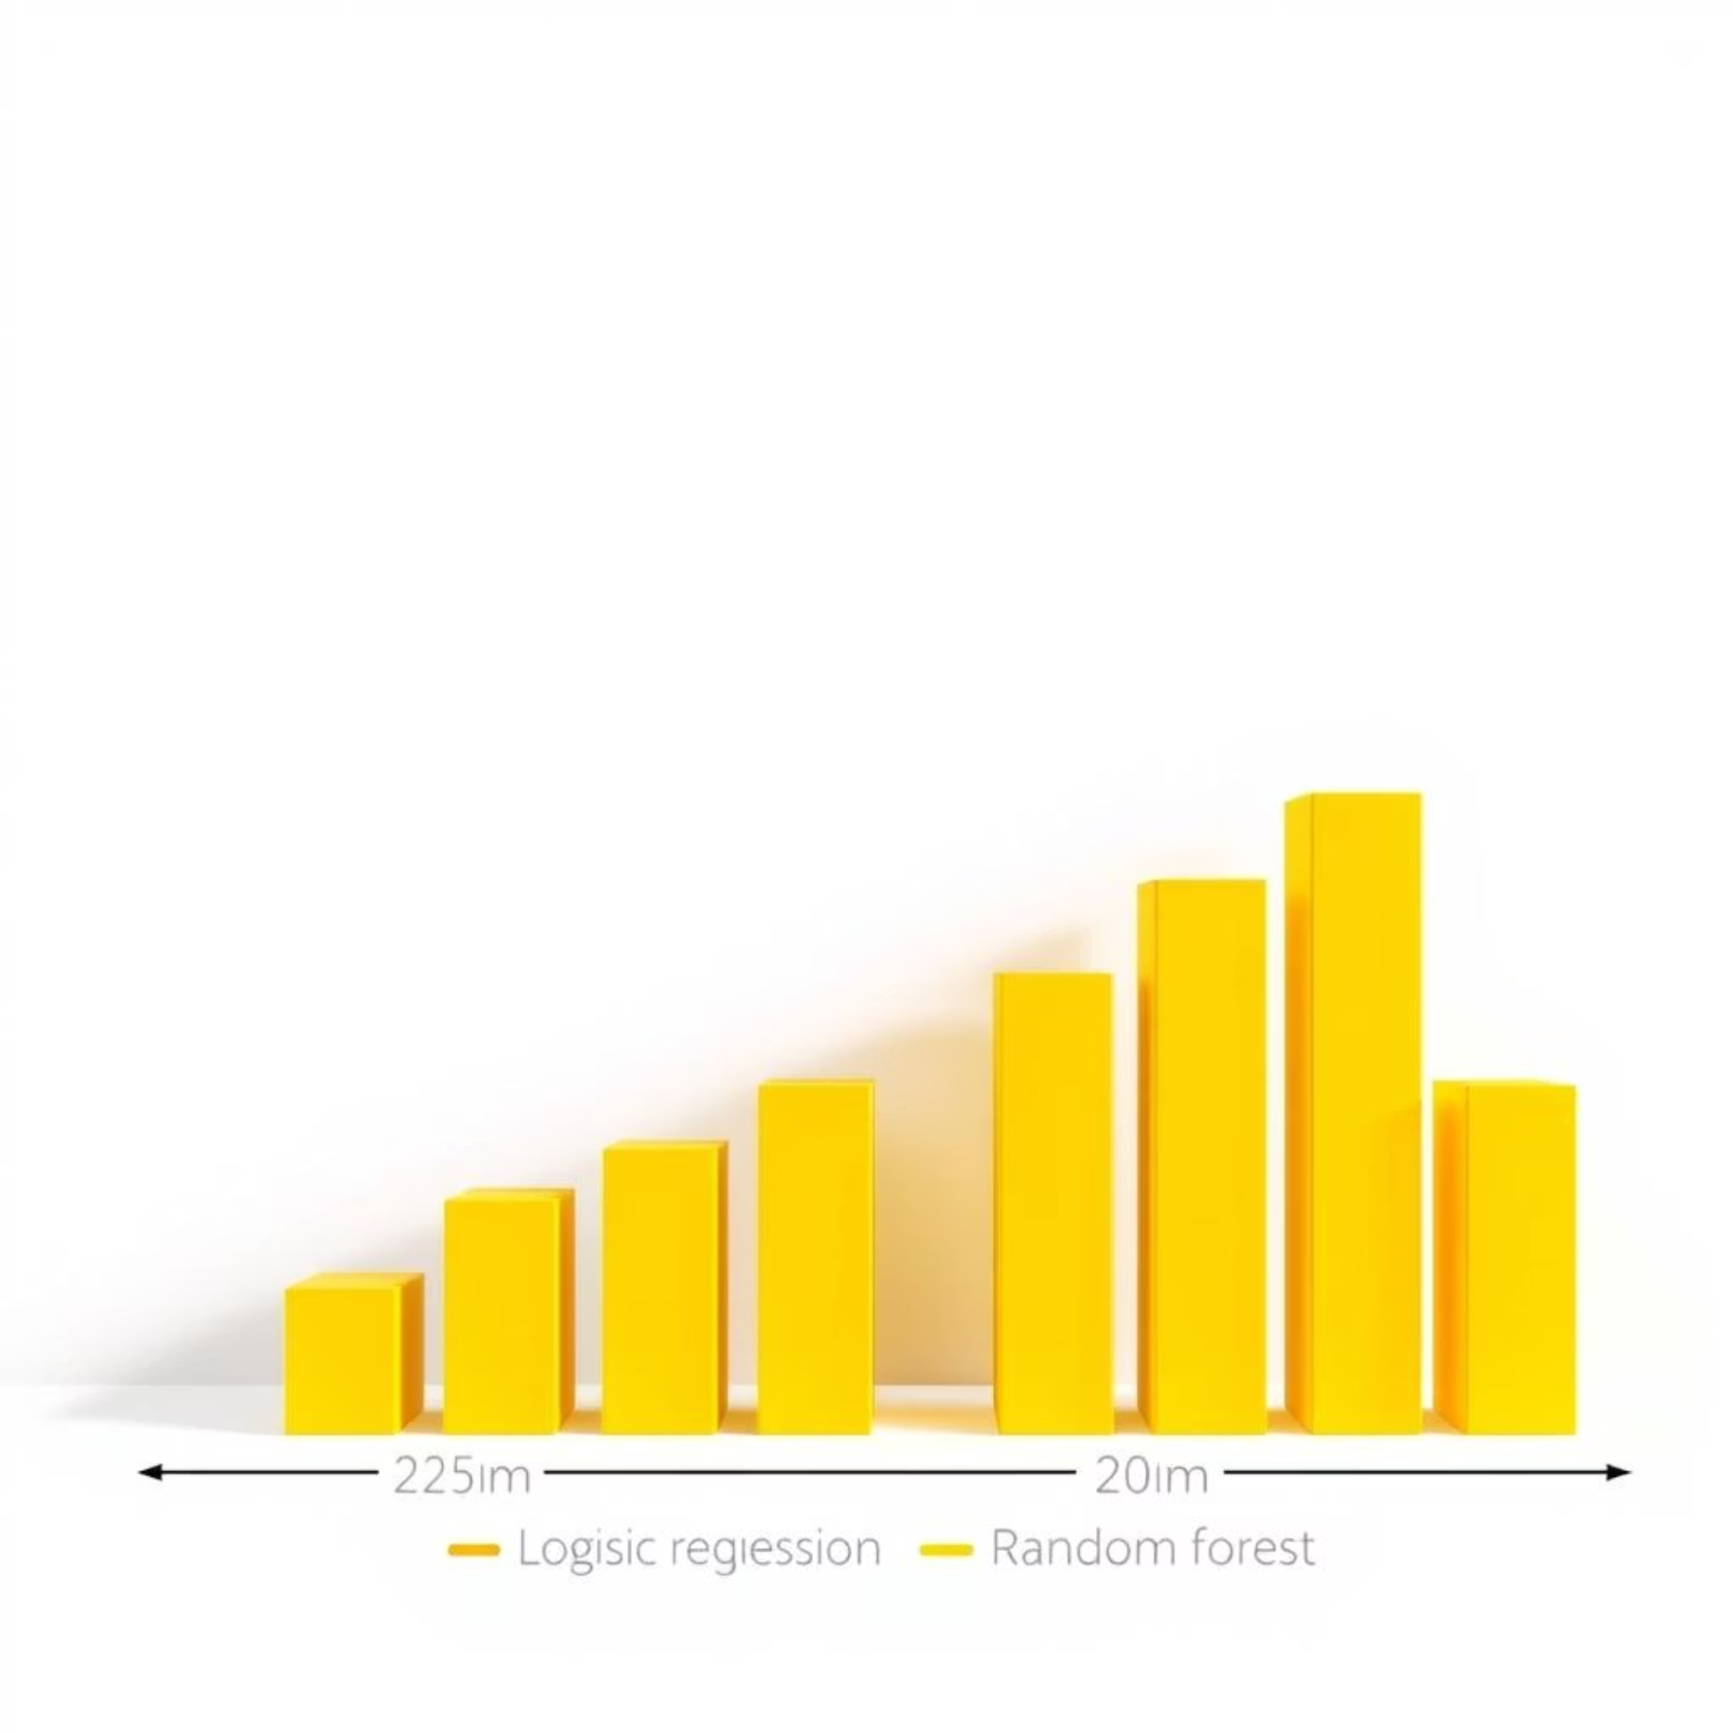

Results, Conclusions, & The Path Forward
Key Findings
Future Directions
Logistic Regression: Achieved a strong accuracy of approximately 94%.
Advanced Models
Random Forest: Surpassed LR with an accuracy of around 97%, demonstrating superior ability to capture complex data patterns.
Explore Support Vector Machines (SVM) and Neural Networks for potential performance gains.
Conclusion: Machine Learning is a powerful and valuable tool to support doctors in breast cancer diagnosis. While Logistic Regression offers simplicity and interpretability, Random Forest provides higher accuracy and robustness, making it the preferred choice for critical real-world applications. Automated prediction systems hold significant potential to enhance healthcare decision-making.
Robust Validation
Implement Cross-Validation techniques to ensure consistent and generalizable results.
Feature Engineering
Develop new, more insightful features from existing data to improve predictive power.
Real-World Integration
Collaborate with medical professionals to integrate models into clinical workflows for practical impact.

